Slide 1

效法我，像我效法基督
Imitate Me, as I Imitate Christ
罗/Rom. 9：1-5

Slide 2

祈祷/Prayer

Slide 3
一、保罗为什么“忧伤”——因他看见同胞的属灵需要
I. Why Was Paul “Sorrowful”? — Because He Saw the Spiritual Need of His Fellow Israelites

Slide 4
9:1-3我在基督里说真话，并不谎言，有我良心被圣灵感动，给我作见证。我是大有忧愁，心里时常伤痛。为我弟兄，我骨肉之亲，就是自己被咒诅，与基督分离，我也愿意。
1 I speak the truth in Christ—I am not lying, my conscience confirms it through the Holy Spirit— 2I have great sorrow and unceasing anguish in my heart. 3For I could wish that I myself were cursed and cut off from Christ for the sake of my people, those of my own race.

Slide 5
二、保罗为什么能够爱——因他经历了恩典、从基督身上看见了榜样
II. Why Was Paul Able to Love? — Because He experienced Grace in His Own Life and saw the Example of Christ
1、他从同胞身上看到了“过去的自已”
1. He Saw His “Former Self” in His Fellow Israelites

Slide 6
徒13：49于是主的道，传遍了那一带地方。50但犹太人挑唆虔敬尊贵的妇女，和城内有名望的人，逼迫保罗，巴拿巴，将他们赶出境外。
49The word of the Lord spread through the whole region. 50But the Jewish leaders incited the God-fearing women of high standing and the leading men of the city. They stirred up persecution against Paul and Barnabas, and expelled them from their region.

Slide 7
14：19但有些犹太人，从安提阿和以哥念来，挑唆众人，就用石头打保罗，以为他是死了，便拖到城外。20门徒正围着他，他就起来，走进城去。第二天，同巴拿巴往特庇去，
19Then some Jews came from Antioch and Iconium and won the crowd over. They stoned Paul and dragged him outside the city, thinking he was dead. 20But after the disciples had gathered around him, he got up and went back into the city. The next day he and Barnabas left for Derbe.

Slide 8
17：5但那不信的犹太人心里嫉妒，招聚了些市井匪类，搭伙成群，耸动合城的人，闯进耶孙的家，要将保罗西拉带到百姓那里。
5But other Jews were jealous; so they rounded up some bad characters from the marketplace, formed a mob and started a riot in the city. They rushed to Jason’s house in search of Paul and Silas in order to bring them out to the crowd.

Slide 9
18：5保罗为道迫切，向犹太人证明耶稣是基督。6他们既抗拒，毁谤，保罗就抖着衣裳说，你们的罪归到你们自己头上，与我无干，从今以后，我要往外邦人那里去。
5When Silas and Timothy came from Macedonia, Paul devoted himself exclusively to preaching, testifying to the Jews that Jesus was the Messiah. 6But when they opposed Paul and became abusive, he shook out his clothes in protest and said to them, “Your blood be on your own heads! I am innocent of it. From now on I will go to the Gentiles.”

Slide 10
提前1:13我从前是亵渎神的，逼迫人的，侮慢人的；然而我还蒙了怜悯，因我是不信不明白的时候而做的。
13Even though I was once a blasphemer and a persecutor and a violent man, I was shown mercy because I acted in ignorance and unbelief.

Slide 11
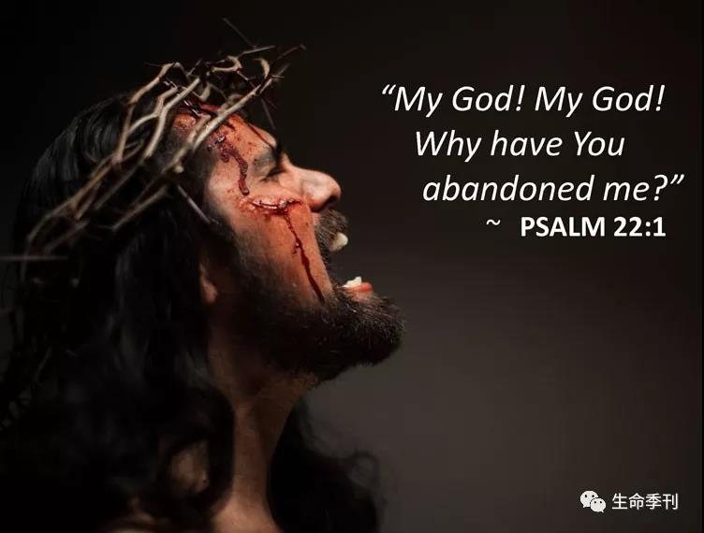
2、保罗有一个榜样——主耶稣基督
2. Paul had an example—the Lord Jesus Christ

Slide 12

三、保罗的呼召——效法我，像我效法基督
III. Paul’s Calling — “Imitate Me, as I Imitate Christ”

Slide 13
1、 保罗从基督身上学会了走十字架的道路
1. Paul Learned from Christ to Walk the Way of the Cross

Slide 14
徒21：10有一个先知，名叫亚迦布，从犹太下来。11到了我们这里，就拿保罗的腰带，捆上自己的手脚，说，圣灵说，犹太人在耶路撒冷，要如此捆绑这腰带的主人，把他交在外邦人手里。12我们和那本地的人，听见这话，都苦劝保罗不要上耶路撒冷去。13保罗说，你们为什么这样痛哭，使我心碎呢？我为主耶稣的名，不但被人捆绑，就是死在耶路撒冷，也是愿意的。

Slide 15
10After we had been there a number of days, a prophet named Agabus came down from Judea. 11Coming over to us, he took Paul’s belt, tied his own hands and feet with it and said, “The Holy Spirit says, ‘In this way the Jewish leaders in Jerusalem will bind the owner of this belt and will hand him over to the Gentiles.’ ”12When we heard this, we and the people there pleaded with Paul not to go up to Jerusalem. 13Then Paul answered, “Why are you weeping and breaking my heart? I am ready not only to be bound, but also to die in Jerusalem for the name of the Lord Jesus.”

Slide 16
1，保罗从基督身上学会了什么是真实的爱
2，Paul Learned from Christ What True Love Is

Slide 17
总结
Summary

